Slide 1
ONLINE RENTAL HOUSE

Slide 2
TABLE NAME: ADMIN
FIELD | DATA TYPE | SIZE | CONSTRAINT
Admin id | Int | 10 | Primary key
Username | Varchar | 30 | Not null
password | Varchar | 30 | Not null

Slide 3
TABLE NAME: HOUSE
FIELD | DATA TYPE | SIZE | CONSTRAINT
house id | Int | 10 | Primary key
House name | Varchar | 20 | Not null
Owner name | Varchar | 20 | Not null
Contact number | Int | 10 | Not null
Address 1 | Varchar | 30 | Not null
Address 2 | Varchar | 30 | Not null
Area name | Varchar | 30 | Not null
City name | Varchar | 20 | Not null
District name | Varchar | 30 | Not null
State name | Varchar | 10 | Not null
Land mark | Varchar | 20 | Not null
Pin code | Varchar | 6 | Not null
Total square fit | Varchar | 5 | Not null
Bed room | Int | 5 | Not null
Hall | Int | 5 | Not null
Kitchen | Int | 5 | Not null
Others | Varchar | 20 | Not null
Price details | Int | 5 | Not null

Slide 4
TABLE NAME: IMAGES
FIELD | DATA TYPE | SIZE | CONSTRAINT
Image id | Int | 10 | Primary key
House id | Int | 10 | Foreign key
Image path | Varchar | 30 | Not null
Image name | Varchar | 20 | Not null

Slide 5
TABLE NAME: CUSTOMER
FIELD | DATA TYPE | SIZE | CONSTRAINT
Customer id | Int | 10 | Primary key
Customer name | Varchar | 20 | Not null
Mobile | Int | 10 | Not null
Email | Varchar | 20 | Not null
Username | Varchar | 20 | Not null
Password | Varchar | 20 | Not null

Slide 6
TABLE NAME: BOOKING
FIELD | DATA TYPE | SIZE | CONSTRAINT
Booking id | Int | 10 | Primary key
Customer id | Int | 10 | Foreign key
House id | Int | 10 | Foreign key
Booking status | Varchar | 20 | Not null

Slide 7
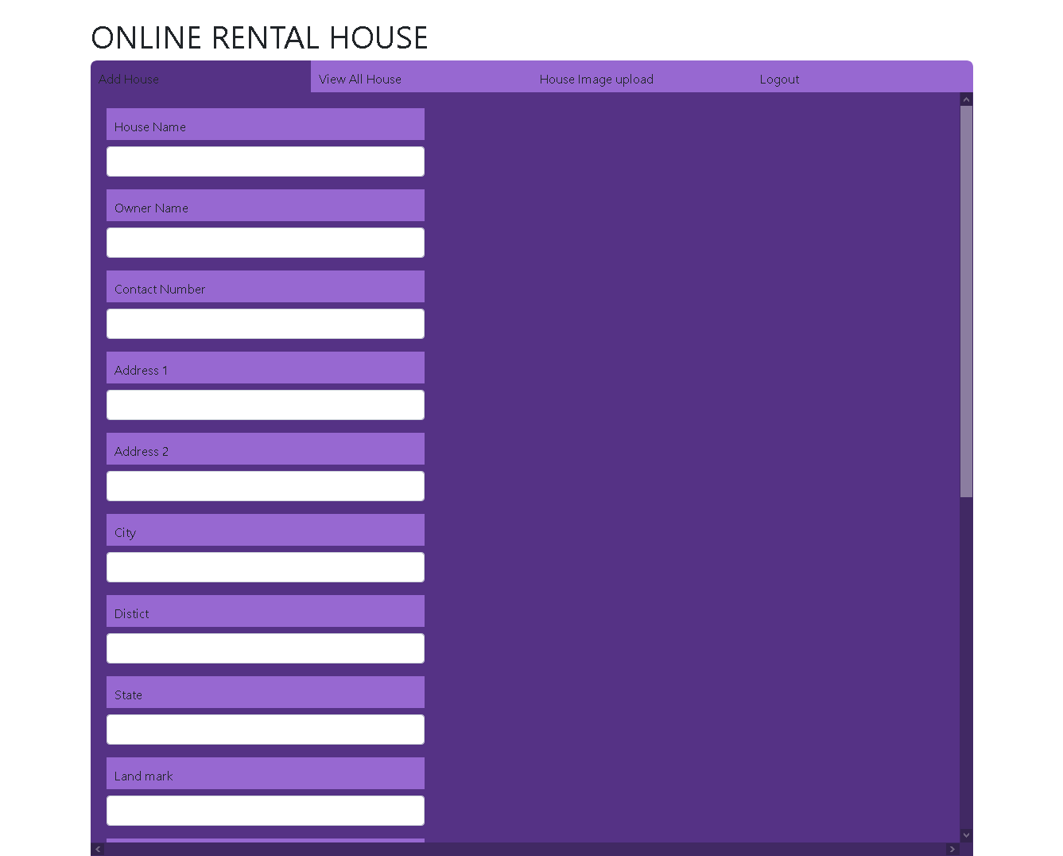

Slide 8
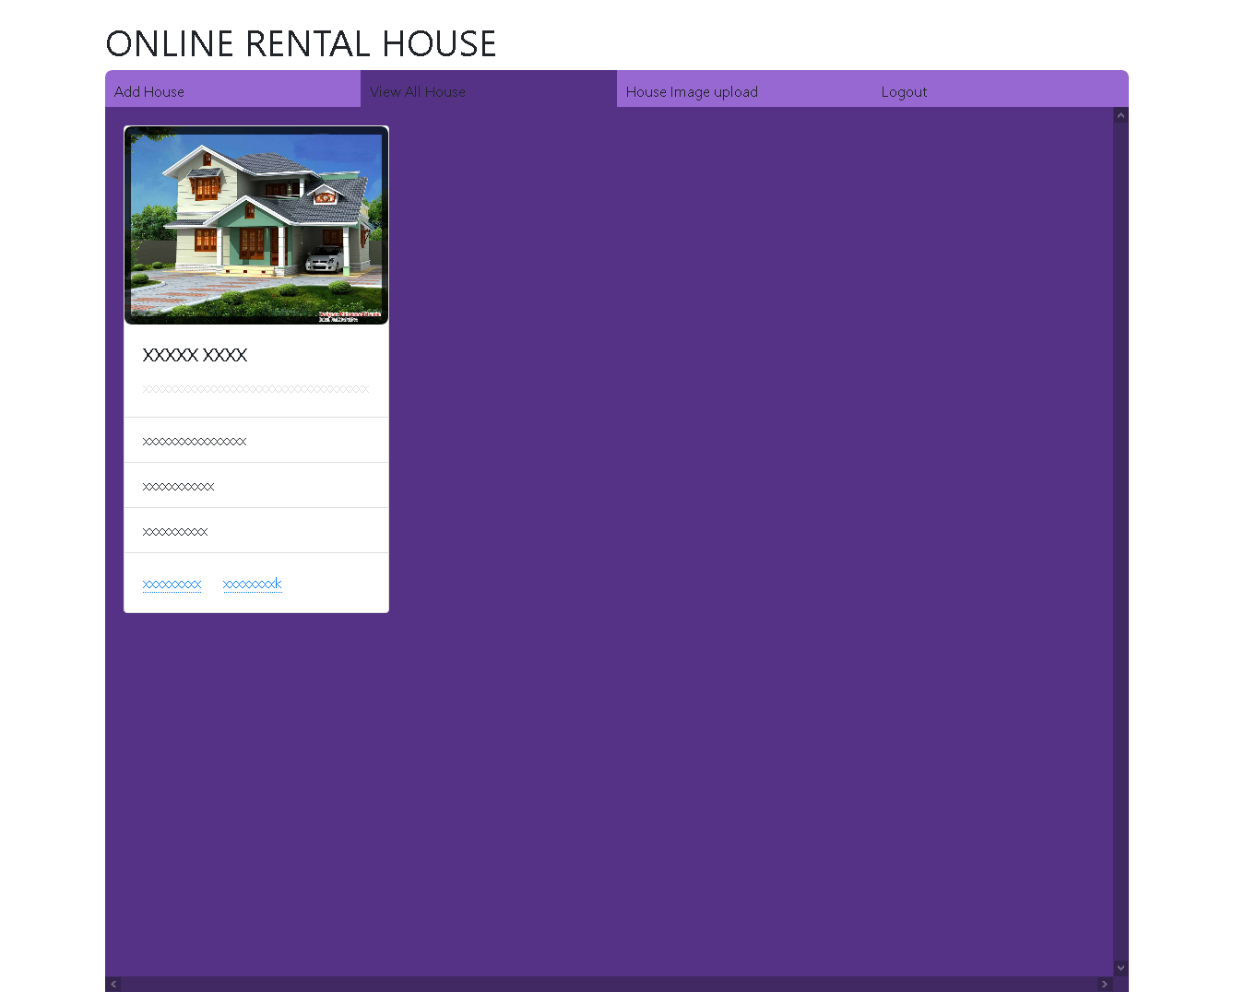

Slide 9
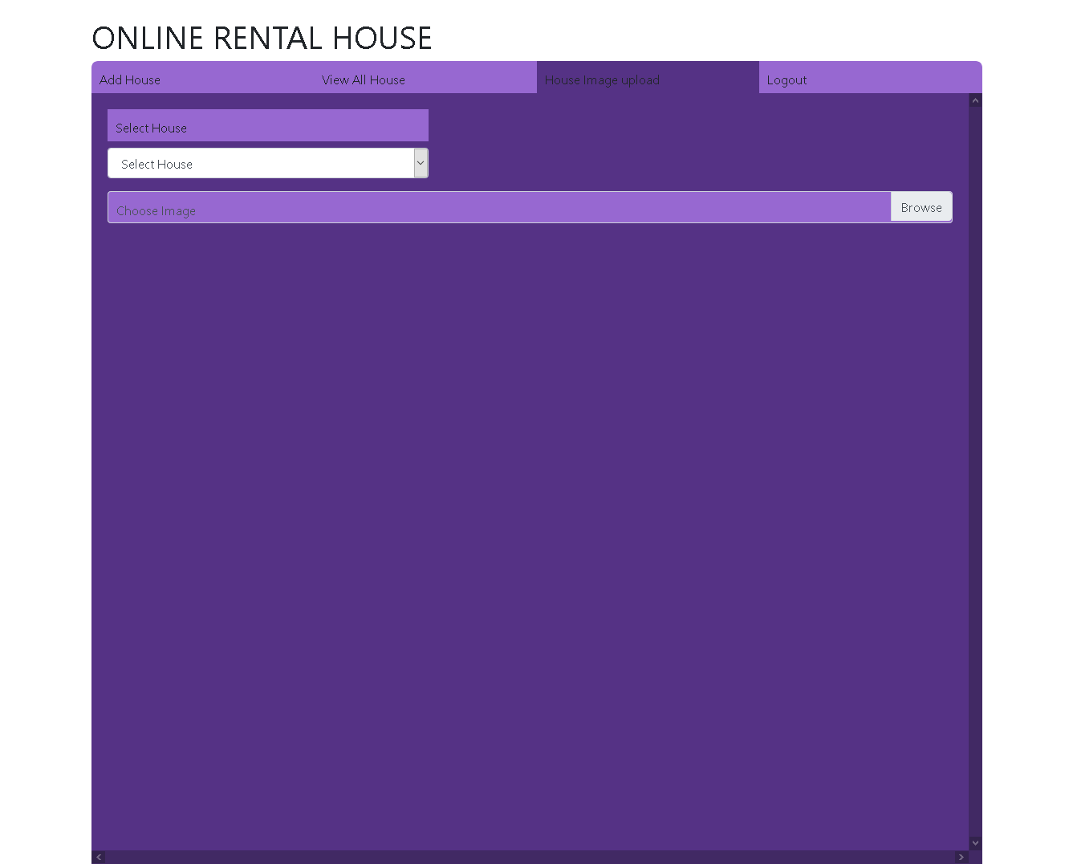

Slide 10
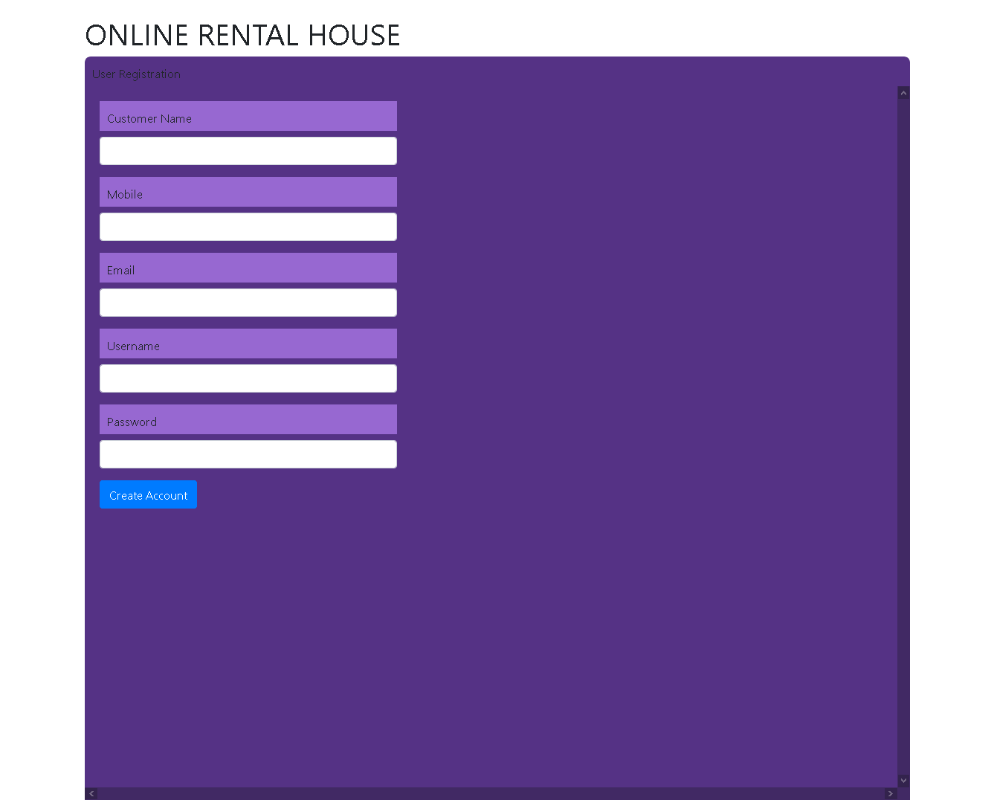

Slide 11
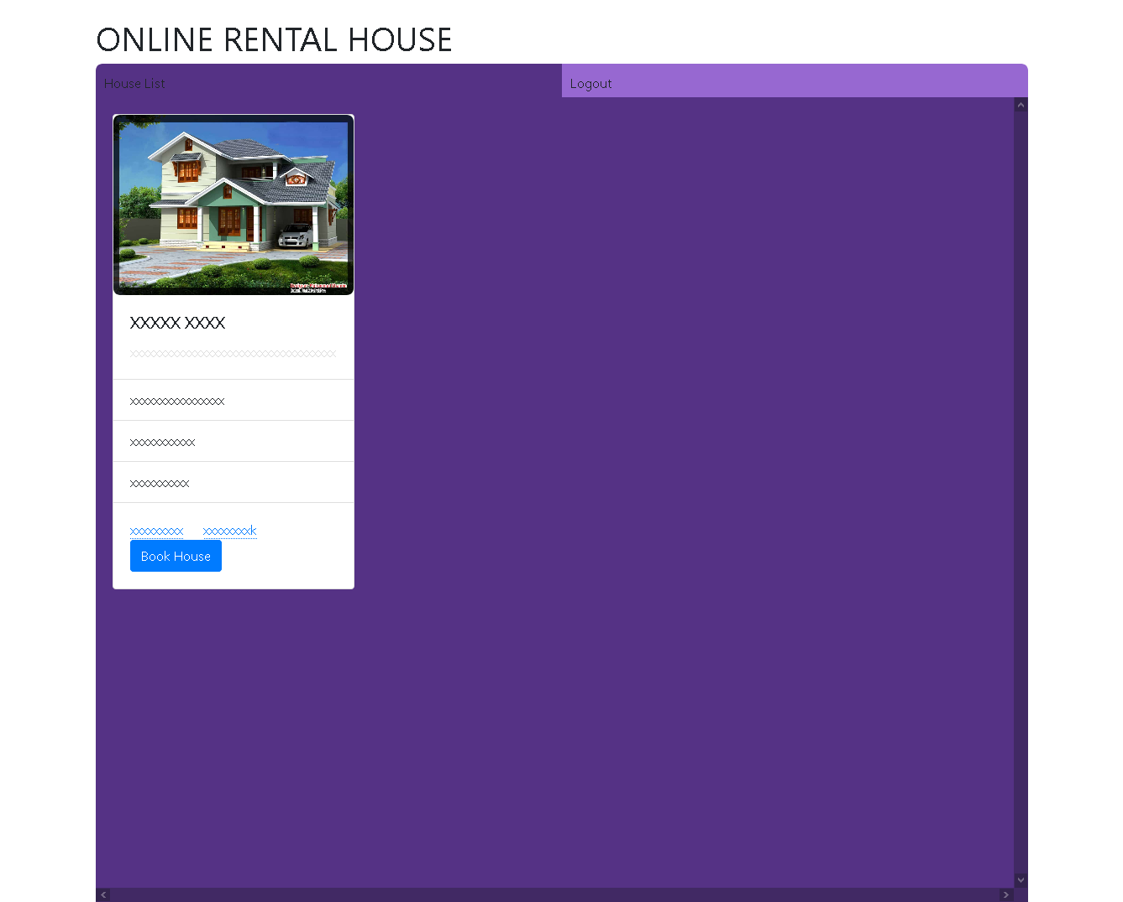

Slide 12
Thank You

